Slide 1
Saurabh Shrestha Data Visualization DSC 640

Slide 2
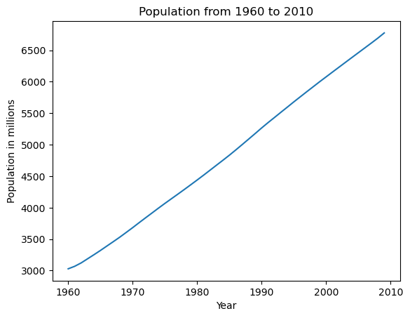
Python – Line Chart

Slide 3
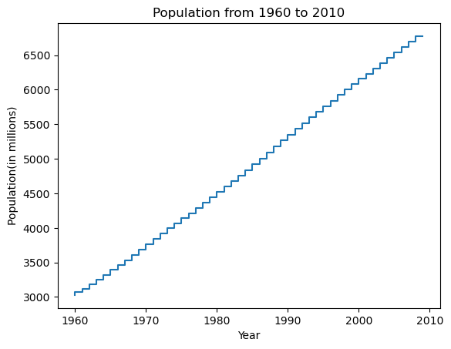
Python – Step Chart

Slide 4
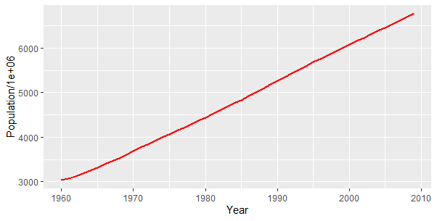
R – Line Chart

Slide 5
R – Step Chart

Slide 6
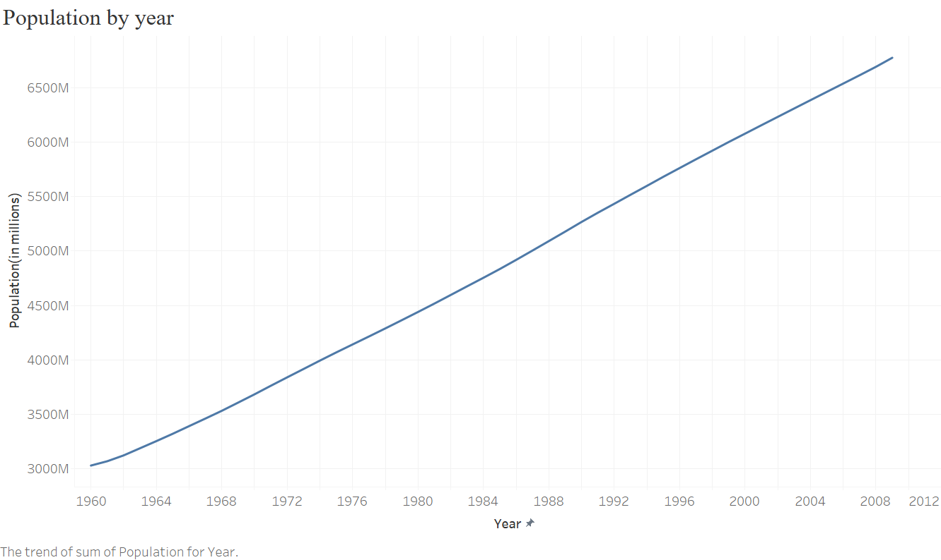
Power BI – Line Chart

Slide 7
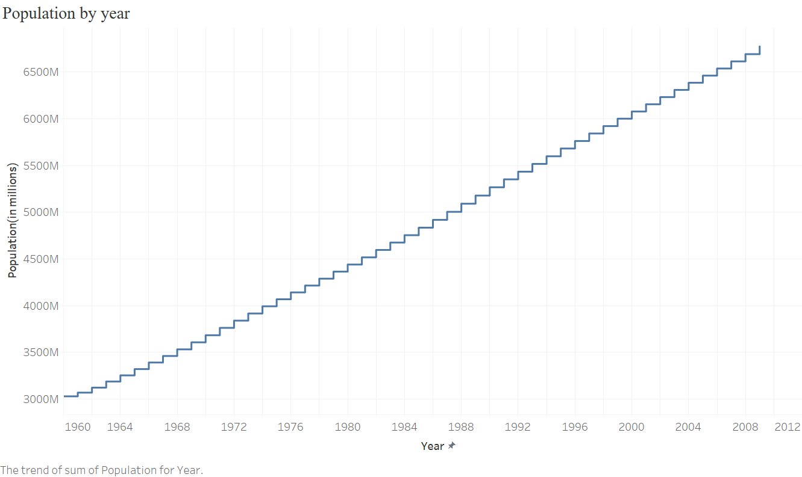
Power BI – Step Chart

